Slide 1

Search
Chris Piech
CS 106B
Lecture 20
Feb 29, 2016
CS 106B
2011

Slide 2
Graph Definition
A graph is a mathematical structure
for representing relationships using nodes and edges.
*Just like a tree without the rules

Slide 3
Twitter Graph
* Finish follows start

Slide 4
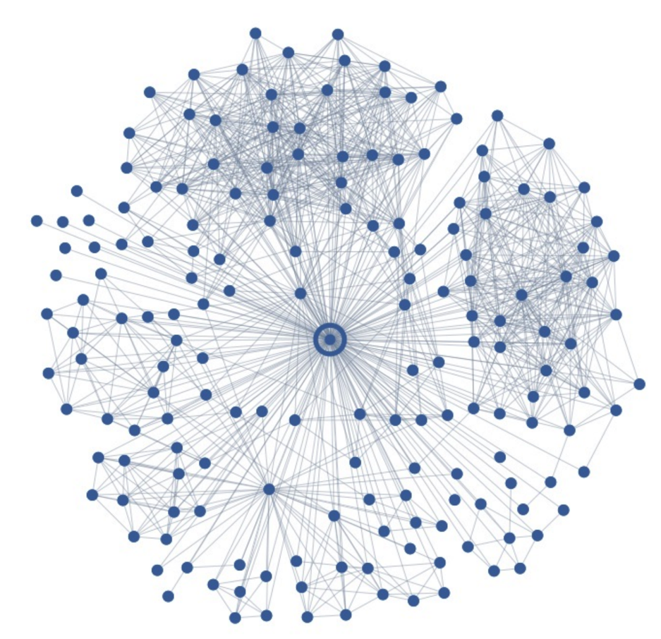
Who Do You Love?
Your significant other
376

Slide 5

Today’s Goal
Depth First Search
Breadth First Search
Chose Between the Two

Slide 6


Today’s Route
Wednesday
Dijkstra’s
Comparison
Breadth
First
Depth
First
Search River

Slide 7
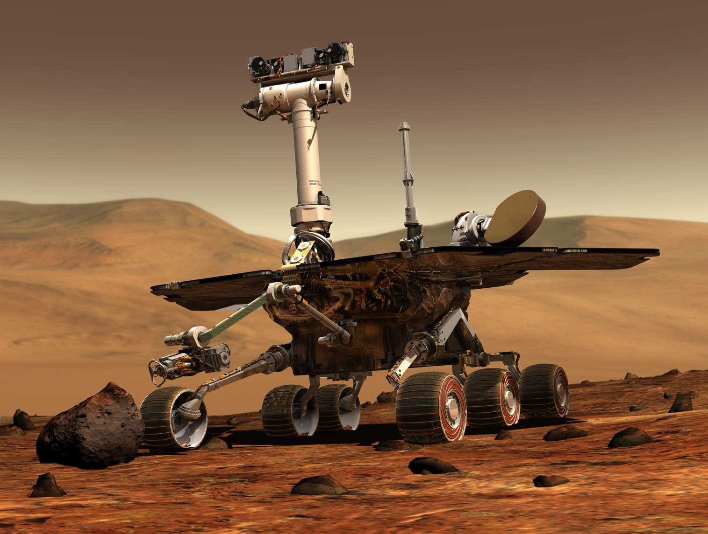
Robot Pathfinding

Slide 8
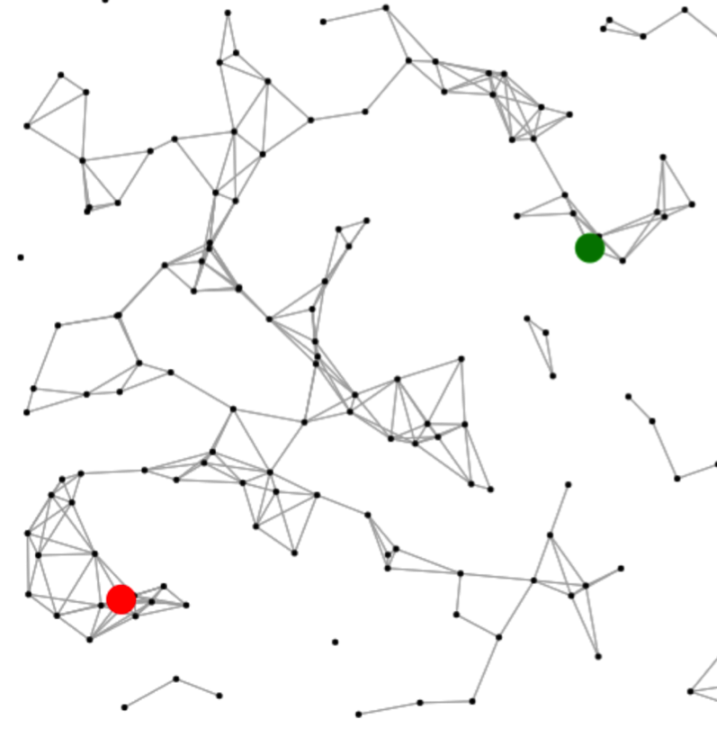
Graph Search

Slide 9
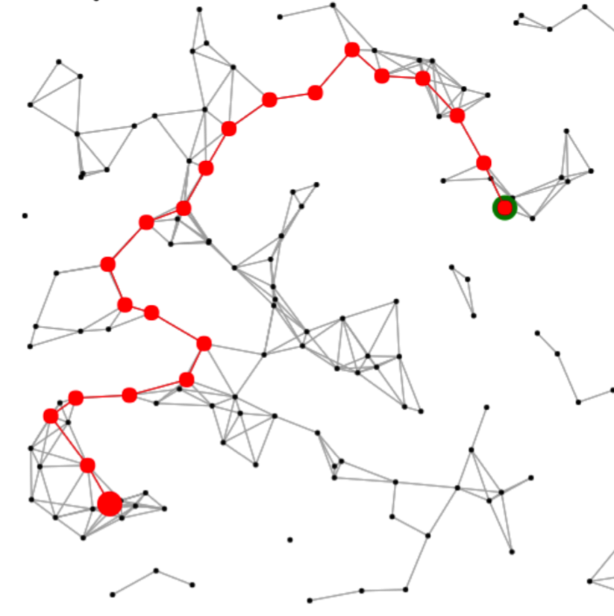
Graph Search

Slide 10
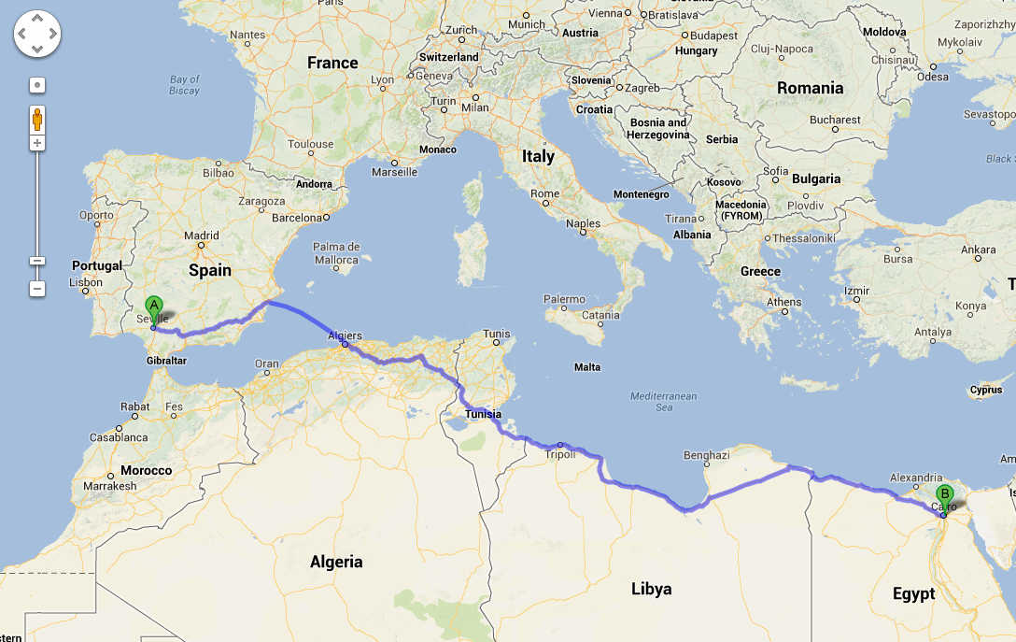
Search is Important

Slide 11
Old friend, Recursive Exploration

Slide 12
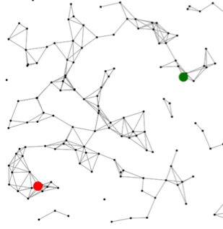
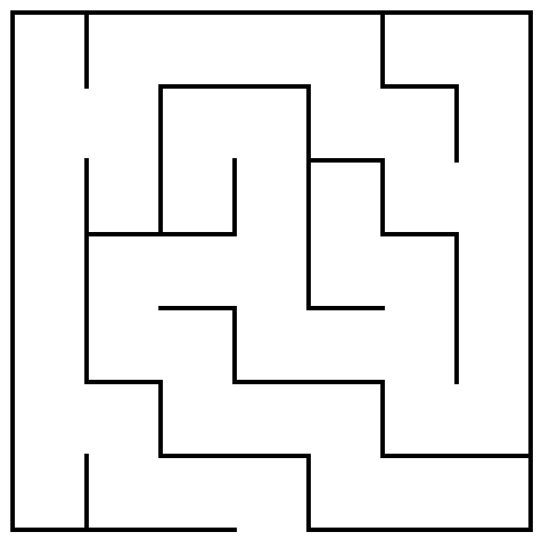
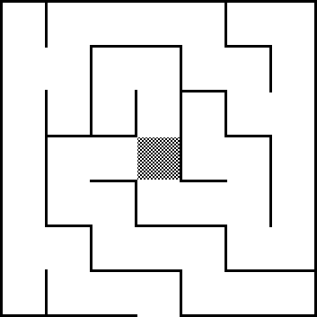
Maze Decision Tree
Θ
Θ
Θ
Θ

Slide 13
Recursive Exploration Solution
bool findPath(BasicGraph & g,
Set<Vertex *> seen,
Vertex * node,
Vertex * goal) {
if(node == goal) return true;
if(seen.contains(node)) return false;
seen.add(node);
for(Vertex* next:g->getNeighbors(node)){
if(findPath(g, seen, next, goal)) {
return true;
}
}
return false;
}

Slide 14
Recursive Exploration Solution
Vector<Vertex *> findPath(BasicGraph & g, Set<Vertex *> seen,
Vector<Vertex *> path, Vertex * goal) {
Vertex * node = path.get(path.size() – 1);
if(node == goal) return path;
if(seen.contains(node)) return emptyPath();
seen.add(node);
for(Vertex * next : g->getNeighbors(node)) {
Vector<Vertex *> newPath = path;
newPath.add(next);
if(!findPath(g, seen, newPath, goal).isEmpty()) {
return newPath;
}
}
return emptyPath();
}
Can be changed to return the path

Slide 15
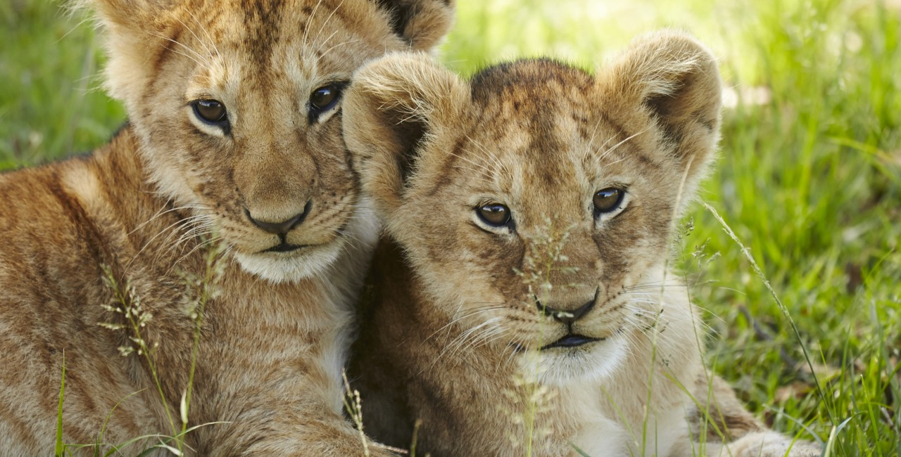
Try it in real ife

Slide 16
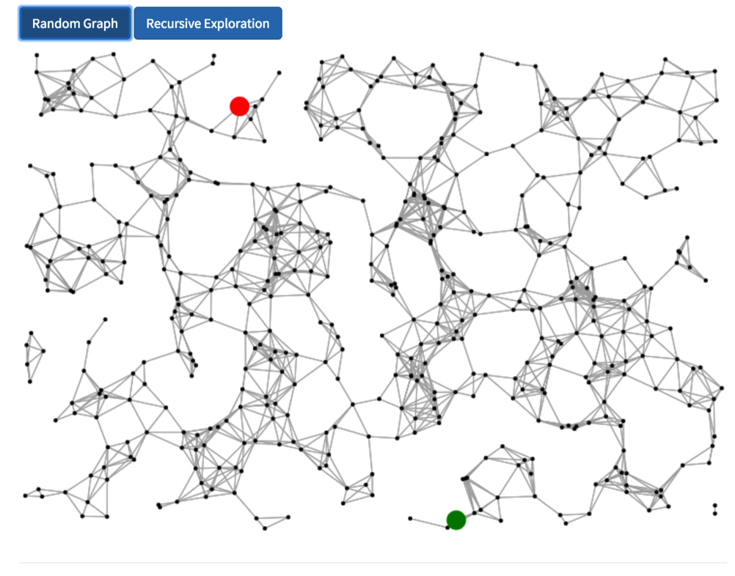
Lets Try it Out!
cs106b.stanford.edu/handouts/search.html

Slide 17
#Rekt

Slide 18
What happened?

Slide 19
Most Simple Graph
Start
Goal

Slide 20
Recursive Exploration Solution
bool findPath(BasicGraph & g,
Set<Vertex *> seen,
Vertex * node,
Vertex * goal) {
if(node == goal) return true;
if(seen.contains(node)) return false;
seen.add(node);
for(Vertex* next:g->getNeighbors(node)){
if(findPath(g, seen, next, goal)) {
return true;
}
}
return false;
}
Start
Goal
Call Stack

Slide 21
Recursive Exploration Solution
bool findPath(BasicGraph & g,
Set<Vertex *> seen,
Vertex * node,
Vertex * goal) {
if(node == goal) return true;
if(seen.contains(node)) return false;
seen.add(node);
for(Vertex* next:g->getNeighbors(node)){
if(findPath(g, seen, next, goal)) {
return true;
}
}
return false;
}
Start
Goal
Call Stack

Slide 22
Recursive Exploration Solution
bool findPath(BasicGraph & g,
Set<Vertex *> seen,
Vertex * node,
Vertex * goal) {
if(node == goal) return true;
if(seen.contains(node)) return false;
seen.add(node);
for(Vertex* next:g->getNeighbors(node)){
if(findPath(g, seen, next, goal)) {
return true;
}
}
return false;
}
Start
Goal
Call Stack

Slide 23
Recursive Exploration Solution
bool findPath(BasicGraph & g,
Set<Vertex *> seen,
Vertex * node,
Vertex * goal) {
if(node == goal) return true;
if(seen.contains(node)) return false;
seen.add(node);
for(Vertex* next:g->getNeighbors(node)){
if(findPath(g, seen, next, goal)) {
return true;
}
}
return false;
}
Start
Goal
Call Stack

Slide 24
Recursive Exploration Solution
bool findPath(BasicGraph & g,
Set<Vertex *> seen,
Vertex * node,
Vertex * goal) {
if(node == goal) return true;
if(seen.contains(node)) return false;
seen.add(node);
for(Vertex* next:g->getNeighbors(node)){
if(findPath(g, seen, next, goal)) {
return true;
}
}
return false;
}
Start
Goal
Call Stack

Slide 25
Recursive Exploration Solution
bool findPath(BasicGraph & g,
Set<Vertex *> seen,
Vertex * node,
Vertex * goal) {
if(node == goal) return true;
if(seen.contains(node)) return false;
seen.add(node);
for(Vertex* next:g->getNeighbors(node)){
if(findPath(g, seen, next, goal)) {
return true;
}
}
return false;
}
Start
Goal
Call Stack

Slide 26
Recursive Exploration Solution
bool findPath(BasicGraph & g,
Set<Vertex *> seen,
Vertex * node,
Vertex * goal) {
if(node == goal) return true;
if(seen.contains(node)) return false;
seen.add(node);
for(Vertex* next:g->getNeighbors(node)){
if(findPath(g, seen, next, goal)) {
return true;
}
}
return false;
}
Start
Goal
Call Stack

Slide 27
How to think about search

Slide 28
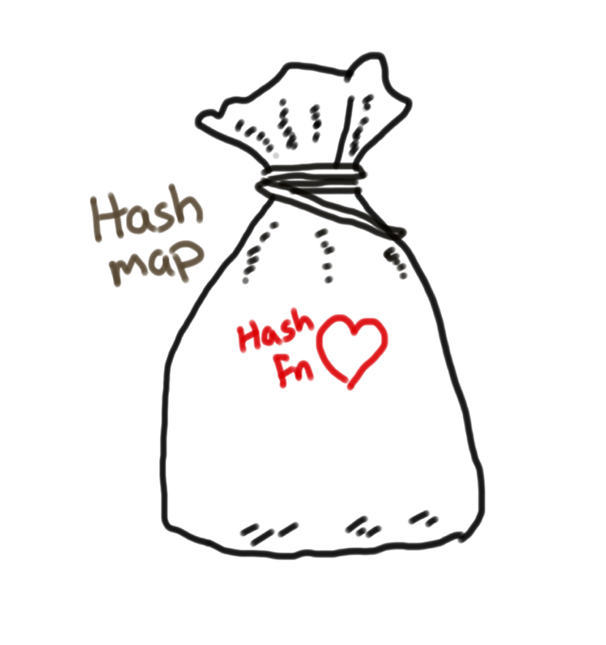
How to Think About Search
Next path to explore
Todo List

Slide 29
How is the todo list stored?

Slide 30
Call Stack!

Slide 31
How to Think About Search
Next path to explore
Todo List:
Stack

Slide 32
This code is equivalent*:
*actually it uses more memory

Slide 33
Depth First Search
stack = Stack()
stack.push(startNode)
seen = Set();
visited = Set([])
while !stack.isEmpty():
currState = stack.pop()
if(currState is goal) return currState;
if(seen contains currState) continue;
seen.add(currState);
if not currState in visited:
for nextState in getNextStates(currState)
stack.push(nextState)
}
}
}

Slide 34
This code is equivalent:

Slide 35
Most Simple Graph
Start
Goal

Slide 36
Depth First Search
Create an empty stack

Slide 37
Depth First Search
Push a path with just the start node

Slide 38
Depth First Search
Enter the while loop

Slide 39
Depth First Search
Pop a path

Slide 40
Depth First Search
Check if its been visited or if it’s the goal

Slide 41
Depth First Search
Create a path for each of its neighbors

Slide 42
Depth First Search
Bottom
Top
Create a path for each of its neighbors

Slide 43
Depth First Search
Create a path for each of its neighbors

Slide 44
Depth First Search
Push the new paths

Slide 45
Depth First Search
Push the new paths

Slide 46
Depth First Search
Back to the start of the while loop

Slide 47
Depth First Search
Bottom
Top
Back to the start of the while loop

Slide 48
Depth First Search
Pop a path

Slide 49
Depth First Search
Check if the last node is a goal or if its been visited

Slide 50
Depth First Search
Create a new path for each neighbor of the last node

Slide 51
Depth First Search
Push the new paths

Slide 52
Depth First Search
Push the new paths

Slide 53
Depth First Search
Back to the start of the while loop

Slide 54
Depth First Search
Pop a path

Slide 55
Depth First Search
Check if the last node is a goal or if its been visited

Slide 56
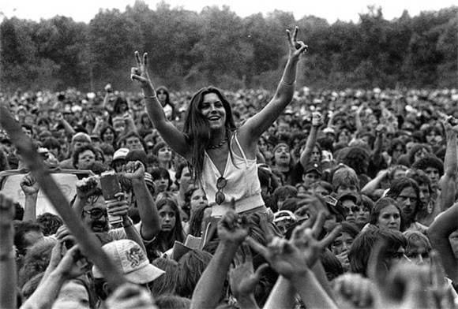
Try it live

Slide 57
#pwned

Slide 58


Slide 59



Stacks are LIFO
LIFO
push and pop
Dish metaphor

Slide 60
Today’s Route
Wednesday
Dijkstra’s
Comparison
Breadth
First
Depth
First
Search River

Slide 61
Today’s Route
Wednesday
Dijkstra’s
Comparison
Breadth
First
Depth
First
Search River

Slide 62
Better Data Structure

Slide 63
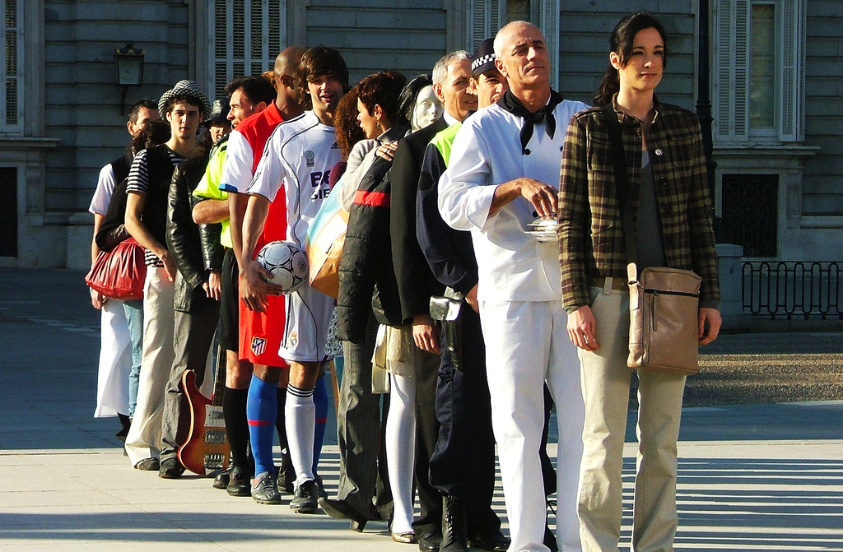
What about a Queue?

Slide 64
Breadth First Search Collection
Next path to explore
Todo List:
Queue

Slide 65
Depth First Search
stack = Stack()
stack.push(newPath(startNode))
seen = Set();
while !stack.isEmpty():
currPath = stack.pop()
currState = last(currPath);
if(currState is goal) return currState;
if(seen contains currState) continue;
seen.add(currState);
for nextState in getNextStates(currState)
path = newPath(currPath, nextState);
stack.push(path);
}
}

Slide 66
Breadth First Search
queue = Queue()
queue.enqueue(newPath(startNode))
seen = Set();
while !queue.isEmpty():
currPath = queue.dequeue()
currState = last(currPath);
if(currState is goal) return currState;
if(seen contains currState) continue;
seen.add(currState);
for nextState in getNextStates(currState)
path = newPath(currPath, nextState);
queue.enqueue(path);
}
}

Slide 67
Most Simple Graph
Start
Goal

Slide 68
Breadth First Search
Enqueue the start state

Slide 69
Breadth First Search
Dequeue the first state

Slide 70
Breadth First Search
Check if it’s the goal or if it has been visited

Slide 71
Breadth First Search
Find each successor state

Slide 72
Breadth First Search
Front
Back
Find each successor state

Slide 73
Breadth First Search
Find each successor state

Slide 74
Breadth First Search
Enqueue the successor states

Slide 75
Breadth First Search
Enqueue the successor states

Slide 76
Breadth First Search
Forget about the dequeued state

Slide 77
Breadth First Search
Back to the start of the while loop

Slide 78
Breadth First Search
Dequeue a state

Slide 79
Breadth First Search
Check if it’s a goal or if the state has been visited

Slide 80
Breadth First Search
Find each successor state

Slide 81
Breadth First Search
Enqueue each successor

Slide 82
Breadth First Search
Enqueue each successor

Slide 83
Breadth First Search
Back to the start of the while loop

Slide 84
Breadth First Search
Dequeue a path

Slide 85
Breadth First Search
Check if it’s a goal

Slide 86
You have seen this before…

Slide 87
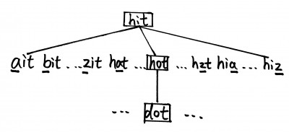
Word Ladder

Slide 88

Try it!
Try it live

Slide 89
Boom!

Slide 90
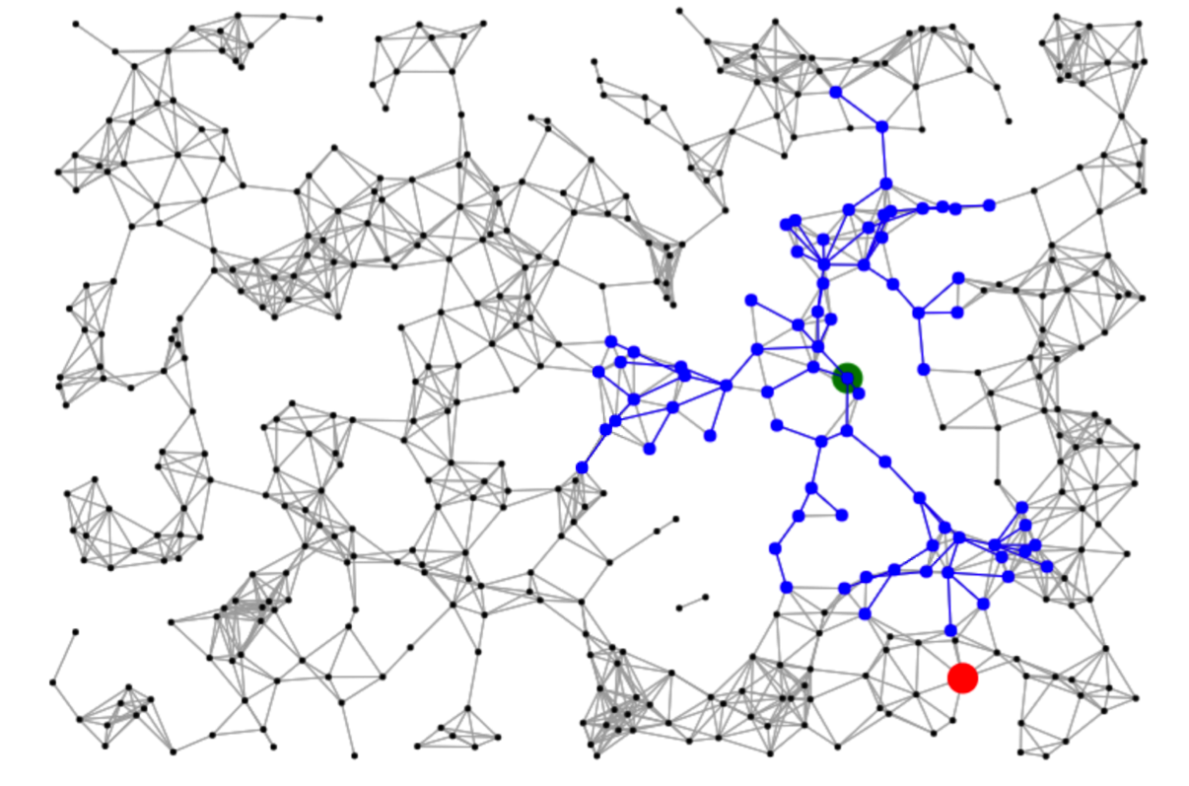
Guaranteed Shortest

Slide 91
Guaranteed Shortest
Must explore all paths of length 1, before any paths of length 2

Slide 92
Guaranteed Shortest
Must explore all paths of length 2, before any paths of length 3

Slide 93
Guaranteed Shortest
Must explore all paths of length k, before any paths of length k+1

Slide 94
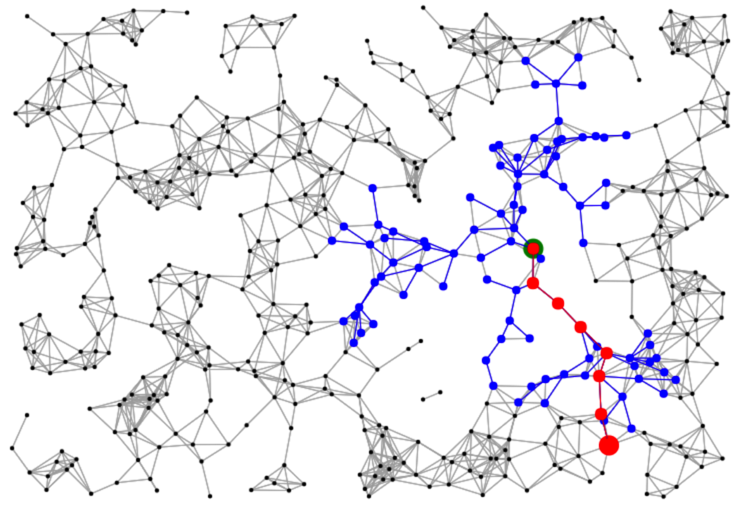
Guaranteed Shortest
When you find a path to an unseen node, it must be the shortest

Slide 95
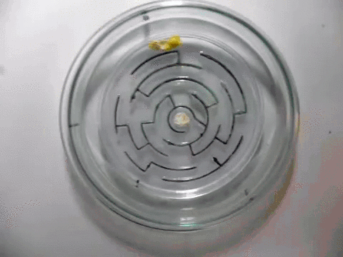
Slimemold BFS

Slide 96
Today’s Route
Wednesday
Dijkstra’s
Comparison
Breadth
First
Depth
First
Search River

Slide 97
Today’s Route
Wednesday
Dijkstra’s
Comparison
Breadth
First
Depth
First
Search River

Slide 98
BFS Pros
It is guaranteed to find the path with the shortest number of hops

Slide 99
BFS Con
It uses a ton of memory (the queue can get very large)

Slide 100
DFS Pros
If you implement depth first search recursively it only has to store a single path in memory! BFS must store all states in the fringe.

Slide 101
DFS Cons
Not guaranteed to find the lowest cost solution for all problems.
Can get lost.

Slide 102
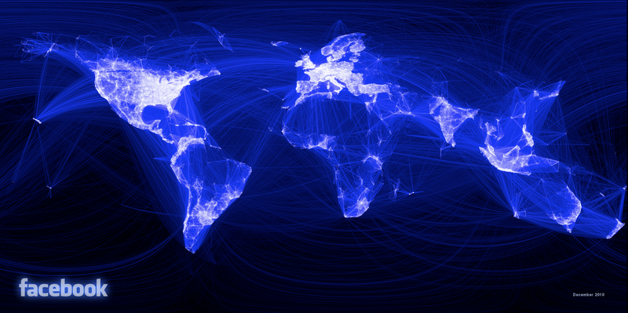
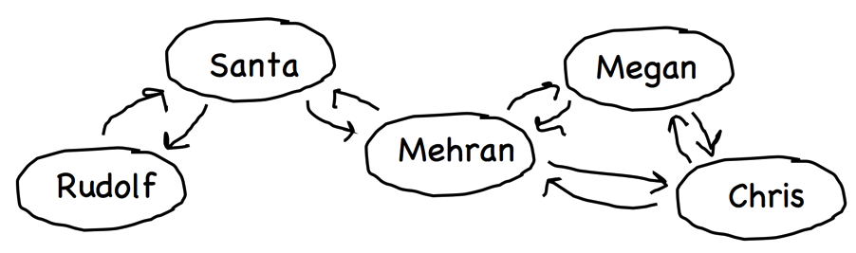
Best of Both Worlds?

Slide 103
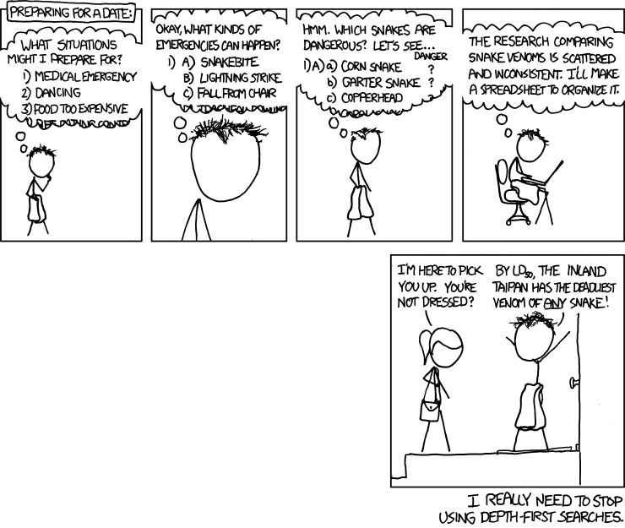

Slide 104
Weights?

Slide 105
Shortest Path
A
C
B
D

Slide 106
With Weights
A
5
C
10
3
B
1,234,332
D

Slide 107
With Weights
A
5
C
10
3
B
1,234,332
D

Slide 108

Realistic

Slide 109
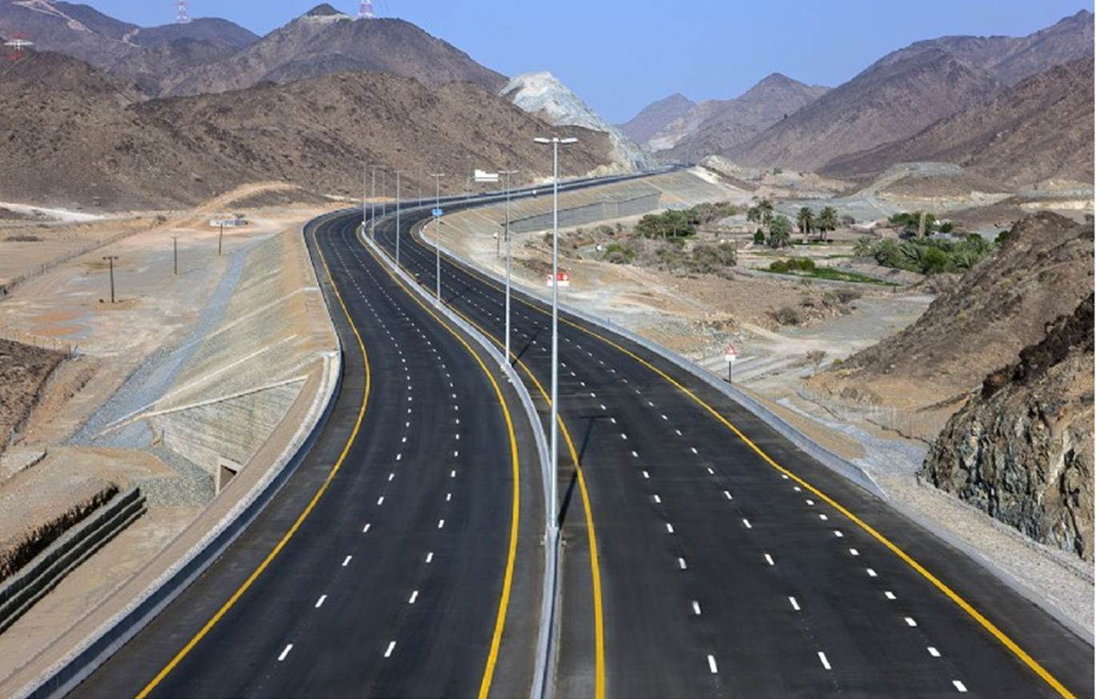
Realistic

Slide 110
Shortest Path Problem
Suppose that you have a graph representing different locations.
Each edge has an associated cost (or weight, length, etc.). We'll assume costs are nonnegative.
Goal: Find the least-cost (or lowest-weight, lowest-length, etc.) path from some node u to a node v.

Slide 111
Today’s Route
Wednesday
Dijkstra’s
Comparison
Breadth
First
Depth
First
Search River

Slide 112
Today’s Route
Wednesday
Dijkstra’s
Comparison
Breadth
First
Depth
First
Search River

Slide 113
Dijkstra’s Collection
Next path to explore
Todo List:
Priority Queue

Slide 114
Breadth First Search
queue = Queue()
queue.enqueue(newPath(startNode))
seen = Set();
while !queue.isEmpty():
currPath = queue.dequeue()
currState = last(currPath);
if(currState is goal) return currState;
if(seen contains currState) continue;
seen.add(currState);
for nextState in getNextStates(currState)
path = newPath(currPath, nextState);
queue.enqueue(path);
}
}

Slide 115
Dijkstra’s Algorithm
pQueue = PriorityQueue()
pQueue.enqueue(newPath(startNode), 0)
seen = Set();
while !pQueue.isEmpty():
currPath = pQueue.dequeue()
currState = last(currPath);
if(currState is goal) return currState;
if(seen contains currState) continue;
seen.add(currState);
for nextState in getNextStates(currState)
path = newPath(currPath, nextState);
pQueue.enqueue(path, getCost(path));
}
}

Slide 116

See it Live
Try it live

Slide 117
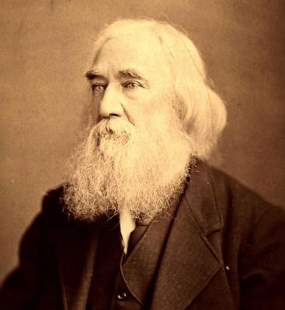
How You Imagine Edsger Dikstra

Slide 118
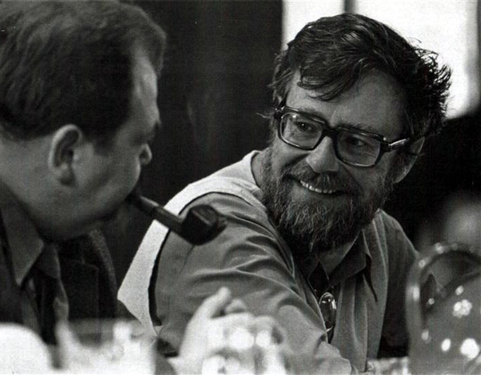
Edsger Dikstra

Slide 119
A
A
B
B
C
6
3
C
3
1
1
D
D
E
E
F
1
7
F
9
4
7
G
G
H
H
I
2
5
I

Slide 120
A
A
0?
B
B
C
6
3
C
3
1
2
1
D
D
E
E
F
1
7
F
9
4
4
7
G
G
H
H
I
2
5
I

Slide 121
A
A
0?
B
B
C
6
3
C
A
0?
3
1
2
1
D
D
E
E
F
1
7
F
9
4
4
7
G
G
H
H
I
2
5
I

Slide 122
A
A
0?
B
B
C
6
3
C
A
0?
3
1
2
1
D
D
E
E
F
1
7
F
9
4
4
7
G
G
H
H
I
2
5
I

Slide 123
A
A
0?
B
B
C
6
3
C
3
1
2
1
D
D
E
E
F
1
7
F
9
4
4
7
G
G
H
H
I
2
5
I

Slide 124
A
A
0
B
B
C
6
3
C
3
1
2
1
D
D
E
E
F
1
7
F
9
4
4
7
G
G
H
H
I
2
5
I

Slide 125
A
A
0
B
B
6?
C
6
3
C
3
1
2
1
D
D
3?
E
E
F
1
7
F
9
4
4
7
G
G
H
H
I
2
5
I

Slide 126
A
A
0
B
B
6?
C
6
3
C
D
3?
3
1
2
1
B
6?
D
D
3?
E
E
F
1
7
F
9
4
4
7
G
G
H
H
I
2
5
I

Slide 127
A
A
0
B
B
6?
C
6
3
C
D
3?
3
1
2
1
B
6?
D
D
3?
E
E
F
1
7
F
9
4
4
7
G
G
H
H
I
2
5
I

Slide 128
A
A
0
B
B
6?
C
6
3
C
D
3?
3
1
2
1
B
6?
D
D
3?
E
E
F
1
7
F
9
4
4
7
G
G
H
H
I
2
5
I

Slide 129
A
A
0
B
B
6?
C
6
3
C
B
6?
3
1
2
1
D
D
3?
E
E
F
1
7
F
9
4
4
7
G
G
H
H
I
2
5
I

Slide 130
A
A
0
B
B
6?
C
6
3
C
B
6?
3
1
2
1
D
D
3
E
E
F
1
7
F
9
4
4
7
G
G
H
H
I
2
5
I

Slide 131
A
A
0
B
B
6?
C
6
3
C
B
6?
3
1
2
1
D
D
3
E
E
4?
F
1
7
F
9
4
4
7
G
G
12?
H
H
I
2
5
I

Slide 132
A
A
0
B
B
6?
C
6
3
C
3
1
2
1
B
6?
D
D
3
E
E
4?
F
1
7
F
9
4
4
7
G
G
12?
H
H
I
2
5
I

Slide 133
A
A
0
B
B
6?
C
6
3
C
E
4?
3
1
2
1
B
6?
D
D
3
E
E
4?
F
1
7
F
G
12?
9
4
4
7
G
G
12?
H
H
I
2
5
I

Slide 134
A
A
0
B
B
6?
C
6
3
C
E
4?
3
1
2
1
B
6?
D
D
3
E
E
4?
F
1
7
F
G
12?
9
4
4
7
G
G
12?
H
H
I
2
5
I

Slide 135
A
A
0
B
B
6?
C
6
3
C
E
4?
3
1
2
1
B
6?
D
D
3
E
E
4?
F
1
7
F
G
12?
9
4
4
7
G
G
12?
H
H
I
2
5
I

Slide 136
A
A
0
B
B
6?
C
6
3
C
B
6?
3
1
2
1
G
12?
D
D
3
E
E
4?
F
1
7
F
9
4
4
7
G
G
12?
H
H
I
2
5
I

Slide 137
A
A
0
B
B
6?
C
6
3
C
B
6?
3
1
2
1
G
12?
D
D
3
E
E
4
F
1
7
F
9
4
4
7
G
G
12?
H
H
I
2
5
I

Slide 138
A
A
0
B
B
6?
C
6
3
C
B
6?
3
1
2
1
G
12?
D
D
3
E
E
4
F
1
7
F
11?
9
4
4
7
G
G
12?
H
H
8?
I
2
5
I

Slide 139
A
A
0
B
B
6?
C
6
3
C
B
6?
3
1
2
1
D
D
3
E
E
4
F
1
7
F
11?
G
12?
9
4
4
7
G
G
12?
H
H
8?
I
2
5
I

Slide 140
A
A
0
B
B
6?
C
6
3
C
B
6?
3
1
2
1
H
8?
D
D
3
E
E
4
F
1
7
F
11?
F
11?
G
12?
9
4
4
7
G
G
12?
H
H
8?
I
2
5
I

Slide 141
A
A
0
B
B
6?
C
6
3
C
B
6?
3
1
2
1
H
8?
D
D
3
E
E
4
F
1
7
F
11?
F
11?
G
12?
9
4
4
7
G
G
12?
H
H
8?
I
2
5
I

Slide 142
A
A
0
B
B
5?
C
6
3
C
B
6?
3
1
2
1
H
8?
D
D
3
E
E
4
F
1
7
F
11?
F
11?
G
12?
9
4
4
7
G
G
12?
H
H
8?
I
2
5
I

Slide 143
A
A
0
B
B
5?
C
6
3
C
B
5?
3
1
2
1
H
8?
D
D
3
E
E
4
F
1
7
F
11?
F
11?
G
12?
9
4
4
7
G
G
12?
H
H
8?
I
2
5
I

Slide 144
A
A
0
B
B
5?
C
6
3
C
B
5?
3
1
2
1
H
8?
D
D
3
E
E
4
F
1
7
F
11?
F
11?
G
12?
9
4
4
7
G
G
12?
H
H
8?
I
2
5
I

Slide 145
A
A
0
B
B
5?
C
6
3
C
B
5?
3
1
2
1
H
8?
D
D
3
E
E
4
F
1
7
F
11?
F
11?
G
12?
9
4
4
7
G
G
12?
H
H
8?
I
2
5
I

Slide 146
A
A
0
B
B
5?
C
6
3
C
B
5?
3
1
2
1
H
8?
D
D
3
E
E
4
F
1
7
F
11?
F
11?
G
12?
9
4
4
7
G
G
12?
H
H
8?
I
2
5
I

Slide 147
A
A
0
B
B
5?
C
6
3
C
H
8?
3
1
2
1
F
11?
D
D
3
E
E
4
F
1
7
F
11?
G
12?
9
4
4
7
G
G
12?
H
H
8?
I
2
5
I

Slide 148
A
A
0
B
B
5
C
6
3
C
H
8?
3
1
2
1
F
11?
D
D
3
E
E
4
F
1
7
F
11?
G
12?
9
4
4
7
G
G
12?
H
H
8?
I
2
5
I

Slide 149
A
A
0
B
B
5
C
6
3
C
8?
H
8?
3
1
2
1
F
11?
D
D
3
E
E
4
F
1
7
F
11?
G
12?
9
4
4
7
G
G
12?
H
H
8?
I
2
5
I

Slide 150
A
A
0
B
B
5
C
6
3
C
8?
H
8?
3
1
2
1
D
D
3
E
E
4
F
1
7
F
11?
F
11?
G
12?
9
4
4
7
G
G
12?
H
H
8?
I
2
5
I

Slide 151
A
A
0
B
B
5
C
6
3
C
8?
H
8?
3
1
2
1
C
8?
D
D
3
E
E
4
F
1
7
F
11?
F
11?
G
12?
9
4
4
7
G
G
12?
H
H
8?
I
2
5
I

Slide 152
A
A
0
B
B
5
C
6
3
C
8?
H
8?
3
1
2
1
C
8?
D
D
3
E
E
4
F
1
7
F
11?
F
11?
G
12?
9
4
4
7
G
G
12?
H
H
8?
I
2
5
I

Slide 153
A
A
0
B
B
5
C
6
3
C
8?
H
8?
3
1
2
1
C
8?
D
D
3
E
E
4
F
1
7
F
11?
F
11?
G
12?
9
4
4
7
G
G
12?
H
H
8?
I
2
5
I

Slide 154
A
A
0
B
B
5
C
6
3
C
8?
C
8?
3
1
2
1
F
11?
D
D
3
E
E
4
F
1
7
F
11?
G
12?
9
4
4
7
G
G
12?
H
H
8?
I
2
5
I

Slide 155
A
A
0
B
B
5
C
6
3
C
8?
C
8?
3
1
2
1
F
11?
D
D
3
E
E
4
F
1
7
F
11?
G
12?
9
4
4
7
G
G
12?
H
H
8
I
2
5
I

Slide 156
A
A
0
B
B
5
C
6
3
C
8?
C
8?
3
1
2
1
F
11?
D
D
3
E
E
4
F
1
7
F
11?
G
12?
9
4
4
7
G
G
12?
H
H
8?
H
8
I
2
5
I
13?

Slide 157
A
A
0
B
B
5
C
6
3
C
8?
C
8?
3
1
2
1
F
11?
D
D
3
E
E
4
F
1
7
F
11?
G
12?
I
13?
9
4
4
7
G
G
12?
H
H
8?
H
8
I
2
5
I
13?

Slide 158
A
A
0
B
B
5
C
6
3
C
8?
C
8?
3
1
2
1
F
11?
D
D
3
E
E
4
F
1
7
F
11?
G
12?
I
13?
9
4
4
7
G
G
12?
H
H
8?
H
8
I
2
5
I
13?

Slide 159
A
A
0
B
B
5
C
6
3
C
8?
C
8?
3
1
2
1
F
11?
D
D
3
E
E
4
F
1
7
F
11?
G
12?
I
13?
9
4
4
7
G
G
10?
H
H
8?
H
8
I
2
5
I
13?

Slide 160
A
A
0
B
B
5
C
6
3
C
8?
C
8?
3
1
2
1
F
11?
D
D
3
E
E
4
F
1
7
F
11?
G
10?
I
13?
9
4
4
7
G
G
10?
H
H
8?
H
8
I
2
5
I
13?

Slide 161
A
A
0
B
B
5
C
6
3
C
8?
C
8?
3
1
2
1
F
11?
D
D
3
E
E
4
F
1
7
F
11?
G
10?
I
13?
9
4
4
7
G
G
10?
H
H
8?
H
8
I
2
5
I
13?

Slide 162
A
A
0
B
B
5
C
6
3
C
8?
C
8?
3
1
2
1
G
10?
D
D
3
E
E
4
F
1
7
F
11?
F
11?
I
13?
I
13?
9
4
4
7
G
G
10?
H
H
8?
H
8
I
2
5
I
13?

Slide 163
A
A
0
B
B
5
C
6
3
C
8?
C
8?
3
1
2
1
G
10?
D
D
3
E
E
4
F
1
7
F
11?
F
11?
I
13?
9
4
4
7
G
G
10?
H
H
8?
H
8
I
2
5
I
13?

Slide 164
A
A
0
B
B
5
C
6
3
C
8?
C
8?
3
1
2
1
G
10?
D
D
3
E
E
4
F
1
7
F
11?
F
11?
I
13?
9
4
4
7
G
G
10?
H
H
8?
H
8
I
2
5
I
13?

Slide 165
A
A
0
B
B
5
C
6
3
C
8?
C
8?
3
1
2
1
G
10?
D
D
3
E
E
4
F
1
7
F
11?
F
11?
I
13?
9
4
4
7
G
G
10?
H
H
8
I
2
5
I
13?

Slide 166
A
A
0
B
B
5
C
6
3
C
8?
C
8?
3
1
1
G
10?
D
D
3
E
E
4
F
1
7
F
11?
F
11?
I
13?
9
4
4
7
G
G
10?
H
H
8
I
2
5
I
13?

Slide 167
A
A
0
B
B
5
C
6
3
C
8?
G
10?
3
1
1
F
11?
D
D
3
E
E
4
F
1
7
F
11?
I
13?
9
4
4
7
G
G
10?
H
H
8
I
2
5
I
13?

Slide 168
A
A
0
B
B
5
C
6
3
C
8
G
10?
3
1
1
F
11?
D
D
3
E
E
4
F
1
7
F
11?
I
13?
9
4
4
7
G
G
10?
H
H
8
I
2
5
I
13?

Slide 169
A
A
0
B
B
5
C
6
3
C
8
G
10?
3
1
1
F
11?
D
D
3
E
E
4
F
1
7
F
11?
I
13?
9
4
4
7
G
G
10?
H
H
8
I
2
5
I
13?

Slide 170
A
A
0
B
B
5
C
6
3
C
8
G
10?
3
1
1
F
9?
D
D
3
E
E
4
F
1
7
F
9?
I
13?
9
4
4
7
G
G
10?
H
H
8
I
2
5
I
13?

Slide 171
A
A
0
B
B
5
C
6
3
C
8
G
10?
3
1
1
F
9?
D
D
3
E
E
4
F
1
7
F
9?
I
13?
9
4
4
7
G
G
10?
H
H
8
I
2
5
I
13?

Slide 172
A
A
0
B
B
5
C
6
3
C
8
F
9?
3
1
1
G
10?
D
D
3
E
E
4
F
1
7
F
9?
I
13?
9
4
4
7
G
G
10?
H
H
8
I
2
5
I
13?

Slide 173
A
A
0
B
B
5
C
6
3
C
8
F
9?
3
1
1
G
10?
D
D
3
E
E
4
F
1
7
F
9?
I
13?
9
4
4
7
G
G
10?
H
H
8
I
2
5
I
13?

Slide 174
A
A
0
B
B
5
C
6
3
C
8
F
9?
3
1
1
G
10?
D
D
3
E
E
4
F
1
7
F
9?
I
13?
9
4
4
7
G
G
10?
H
H
8
I
2
5
I
13?

Slide 175
A
A
0
B
B
5
C
6
3
C
8
F
9?
3
1
2
1
G
10?
D
D
3
E
E
4
F
1
7
F
9?
I
13?
9
4
4
7
G
G
10?
H
H
8
I
2
5
I
13?

Slide 176
A
A
0
B
B
5
C
6
3
C
8
F
9?
3
1
2
1
G
10?
D
D
3
E
E
4
F
1
7
F
9?
I
13?
9
4
4
7
G
G
10?
H
H
8
I
2
5
I
13?

Slide 177
A
A
0
B
B
5
C
6
3
C
8
G
10?
3
1
2
1
I
13?
D
D
3
E
E
4
F
1
7
F
9?
9
4
4
7
G
G
10?
H
H
8
I
2
5
I
13?

Slide 178
A
A
0
B
B
5
C
6
3
C
8
G
10?
3
1
2
1
I
13?
D
D
3
E
E
4
F
1
7
F
9
9
4
4
7
G
G
10?
H
H
8
I
2
5
I
13?

Slide 179
A
A
0
B
B
5
C
6
3
C
8
G
10?
3
1
2
1
I
13?
D
D
3
E
E
4
F
1
7
F
9
9
4
4
7
G
G
10?
H
H
8
I
2
5
I
13?

Slide 180
A
A
0
B
B
5
C
6
3
C
8
G
10?
3
1
2
1
I
13?
D
D
3
E
E
4
F
1
7
F
9
9
4
4
7
G
G
10?
H
H
8
I
2
5
I
13?

Slide 181
A
A
0
B
B
5
C
6
3
C
8
G
10?
3
1
2
1
I
13?
D
D
3
E
E
4
F
1
7
F
9
9
4
4
7
G
G
10?
H
H
8
I
2
5
I
13?

Slide 182
A
A
0
B
B
5
C
6
3
C
8
G
10?
3
1
2
1
I
13?
D
D
3
E
E
4
F
1
7
F
9
9
4
4
7
G
G
10?
H
H
8
I
2
5
I
13?

Slide 183
A
A
0
B
B
5
C
6
3
C
8
G
10?
3
1
2
1
I
13?
D
D
3
E
E
4
F
1
7
F
9
9
4
4
7
G
G
10?
H
H
8
I
2
5
I
13?

Slide 184
A
A
0
B
B
5
C
6
3
C
8
I
13?
3
1
2
1
D
D
3
E
E
4
F
1
7
F
9
9
4
4
7
G
G
10?
H
H
8
I
2
5
I
13?

Slide 185
A
A
0
B
B
5
C
6
3
C
8
I
13?
3
1
2
1
D
D
3
E
E
4
F
1
7
F
9
9
4
4
7
G
G
10
H
H
8
I
2
5
I
13?

Slide 186
A
A
0
B
B
5
C
6
3
C
8
I
13?
3
1
2
1
D
D
3
E
E
4
F
1
7
F
9
9
4
4
7
G
G
10
H
H
8
I
2
5
I
13?

Slide 187
A
A
0
B
B
5
C
6
3
C
8
I
13?
3
1
2
1
D
D
3
E
E
4
F
1
7
F
9
9
4
4
7
G
G
10
H
H
8
I
2
5
I
13?

Slide 188
A
A
0
B
B
5
C
6
3
C
8
3
1
2
1
D
D
3
E
E
4
F
1
7
F
9
9
4
4
7
G
G
10
H
H
8
I
2
5
I
13?

Slide 189
A
A
0
B
B
5
C
6
3
C
8
3
1
2
1
D
D
3
E
E
4
F
1
7
F
9
9
4
4
7
G
G
10
H
H
8
I
2
5
I
13

Slide 190
A
A
0
B
B
5
C
6
3
C
8
3
1
2
1
D
D
3
E
E
4
F
1
7
F
9
9
4
4
7
G
G
10
H
H
8
I
2
5
I
13

Slide 191
Robot Pathfinding

Slide 192
Search is Important

Slide 193
Summary
Algorithm
Collection
Benefit
Depth First Search
Stack
Uses little memory
Breadth First Search
Queue
Finds shortest hops
Dijkstra’s
Priority Queue
Finds shortest path

Slide 194
Today’s Route
Friday
Lover
Twitter
Graphs n
C++
Graphs
Graph River

Slide 195
Today’s Goal
Depth First Search
Breadth First Search
Chose Between the Two

